Slide 1



FIND YOUR SPACE
Why work in the UK space sector?

Slide 2
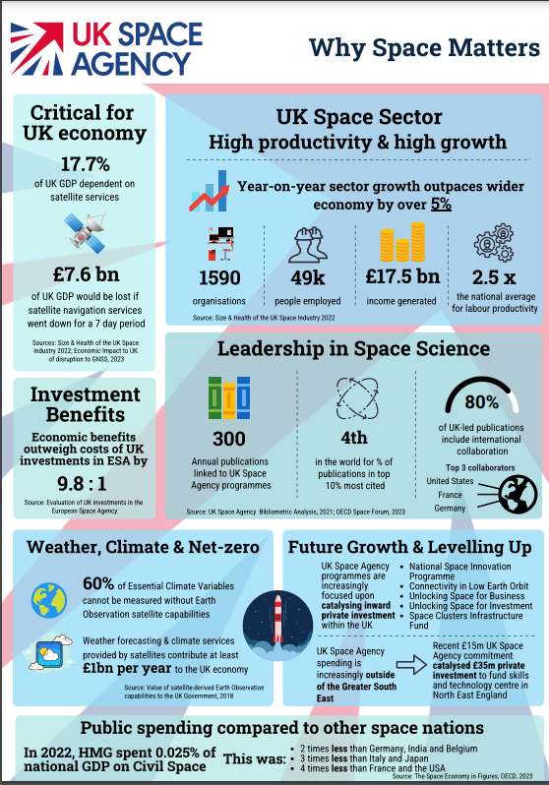
Why work in the UK space sector?
Space is one of the fastest growing sectors of the UK economy, supporting jobs for some 117,000 people. With the motivation, and the right skills and qualifications, you could join them.
Careers in space cover everything from building spacecraft and designing satellites, to co-ordinating disaster relief and forecasting future climate. You could also help develop new technology, search for life on distant worlds or work with astronauts.

Slide 3
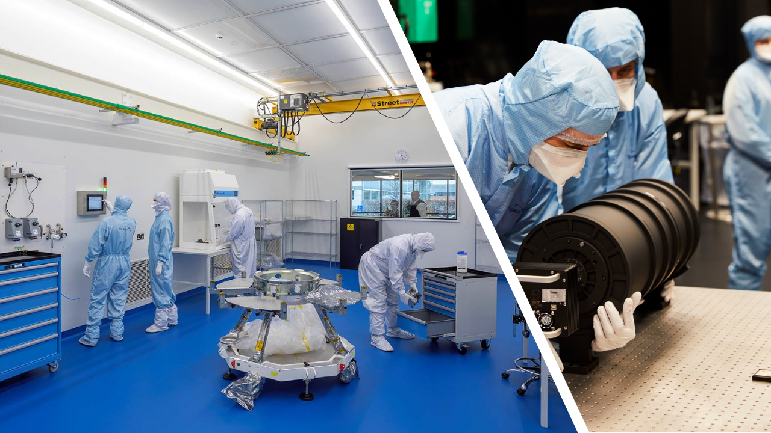
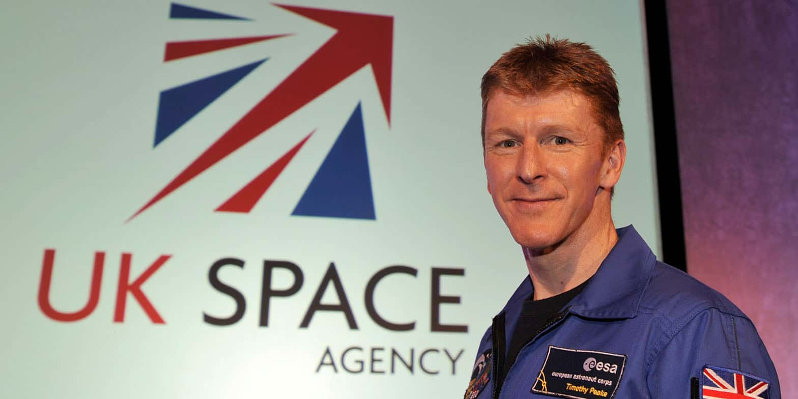
The space industry employs engineers and scientists, accountants, lawyers and communicators. There are jobs in the public and private sectors, in universities, major multinational companies and small enterprises.
UK teams are building some of the world’s largest – and smallest – satellites. They are constructing the first European Mars rover and are working on missions to the Moon, Mercury and Jupiter.

Slide 4







Most careers in space require innovation, creativity, teamwork and problem solving. Many jobs cover multiple disciplines and, as space is an international endeavour, they often involve working with partners around the world.
There are plenty of opportunities available for apprentices and graduates.
Studying science, engineering, IT and maths – as well as related subjects, such as geography – will put you in a strong position for a wide range of space careers.

Slide 5
Which subjects do you enjoy the most?
Can you link each subject to space careers?
Physics
Chemistry
Biology
Art
History
Geography
Languages
P.E.
Design & technology
Maths
English
Information technology

Slide 6
Jobs in the space sector include many disciplines of science.
Physics
Chemistry
Biology
Can you match the following disciplines to the most appropriate branch of science?
Some may relate to more than one, try completing the Venn diagram to show this.
planetary science
Cosmology
Geology
Astronomy
Zoology
Medicine
Astro-physics
Meteor-ology
Bio-chemistry
Micro-biology
Botany
Ecology
Astro-Biology
Astro-chemistry

Slide 7
Physics
Chemistry
Can you put the science disciplines into the correct category?
Some may be in more than one.
Biology

Slide 8
Astrophysics
Cosmology
Geology
Astrochemistry
Meteorology
Astronomy
Physics
Planetary sciences
Chemistry
Medicine
Biochemistry
Astrobiology
Zoology
Microbiology
Botany
Ecology
Suggested answers.
Biology

Slide 9
Which careers are you interested in?
Answer the following questions and take a note of the letters associated with your answer.
Whichever letters you get the most of will tell you which space careers videos you might be interested in watching.

Slide 10
Which would you enjoy the most?
Designing something
Building something
Fixing something
Planning something
E,A,R
M
E,M
B,F,L

Slide 11
Which would you enjoy the most?
Writing a good story.
Reading a good story.
Telling a good story.
C,R,F
R,H,L
C,F,A

Slide 12
Do you enjoy working with?
Data
Machines
people
Materials
R,F,C,B
E,M,P
L,C,H,T
A,E,M

Slide 13
Which of these would you most like to do?
Problem solving
Meeting people
Travel
Creating
E,M,B,L
B,H,C,T
L,B,P
A,E,M,C

Slide 14
What would you most like to do at 18?
Go to university
travel
Start work
apprenticeship
https://www.ucas.com/undergraduate/applying-to-university
https://www.prospects.ac.uk/jobs-and-work-experience/gap-year
https://www.studentjob.co.uk/ages/jobs-18-year-olds
https://www.apprenticeships.gov.uk/apprentices

Slide 15
What letters did you get the most?
E
Engineering - Ben, Faye, Parthil
Manufacturing - Angela, Kelsey
Business management - Amar, Craig
Creative / Artist - Loz, Paul
Law - Joanne
Research - Colin, Rochelle, Hannah
Lecturer / Professor - Sarah, Elisa
Education management - David
Science journalism - Dhara, Melissa
Human resources - Asha
Military - Jason
M
B
A
L
R
F
T
C
H
P

Slide 16

Ben – Design Engineer
You can get into this job through:
A university course, an apprenticeship or applying directly.
University
You'll normally need a foundation degree, higher national diploma or degree.
You could choose from subjects like:
engineering product design
industrial design
computer-aided design engineering
engineering design and manufacture
materials science
maths and physics
Mechanical, electrical and civil engineering qualifications may also be welcomed by employers.
Entry requirements
You'll usually need:
1 or 2 A levels, or equivalent, for a foundation degree or higher national diploma
2 to 3 A levels, or equivalent, for a degree
Link to video - https://youtu.be/0my9Yk1DnFw
E
The average salary for a Design Engineer in the UK is £30,100.
https://nationalcareers.service.gov.uk/job-profiles/design-and-development-engineer
https://www.payscale.com/research/UK/Job=Design_Engineer/Salary
https://www.prospects.ac.uk/job-profiles/design-engineer

Slide 17

Amar – Space Business Manager
You can get into this job through:
A university course, an apprenticeship, working towards this role or a graduate training scheme.
University
Getting a degree in any subject can help you get into this type of job, although business or project management may give you an advantage.
You can take postgraduate qualifications in project management to increase your understanding, though they are not essential for getting into the role.
Entry requirements
You'll usually need:
2 to 3 A levels, or equivalent, for a degree
Link to video - https://youtu.be/h75rsj8sZ6c
B
The average salary for a Business Manager in the UK is £36,079.
https://nationalcareers.service.gov.uk/job-profiles/business-project-manager
https://www.payscale.com/research/UK/Job=Business_Manager/Salary
https://www.prospects.ac.uk/job-profiles/business-development-manager

Slide 18

Loz – Space Artist
You can get into this job through:
A university course, a college course or self-teaching
University
You'll need a high level of skill and talent in your chosen art form. To develop these skills, you could train by doing a degree or postgraduate award in:
art and design
art history
fine art
visual arts
graphic arts
Entry requirements
You'll usually need:
a foundation diploma in art and design
2 to 3 A levels, or equivalent, for a degree
a degree in a relevant subject for postgraduate study
Link to video - https://youtu.be/5Raf0pc_y3s
A
The average salary for a Graphic Artist in the UK is £19,897.
https://nationalcareers.service.gov.uk/job-profiles/fine-artist
https://www.payscale.com/research/UK/Job=Graphic_Artist/Salary
https://www.prospects.ac.uk/job-profiles/fine-artist

Slide 19

Joanne – Space Lawyer
You can get into this job through:
A university course, an apprenticeship, working towards this role and the traditional solicitor qualifying route until 2032
University
In order to qualify, you must:
take an undergraduate degree or equivalent qualification, in any subject
pass part 1 and 2 of the Solicitors Qualifying Exam (SQE)
complete 2 years (or equivalent if part-time) qualifying work experience
meet the character and suitability requirements of the Solicitors Regulation Authority (SRA)
Though your degree does not have to be in Law, you will need some legal knowledge to pass the SQE.
To study Law at some universities you'll need to pass the Law National Aptitude Test (LNAT).
Link to video - https://youtu.be/QjHyLCmq53E
L
Lawyer is a general term referring to anyone who is qualified to give legal advice as a licensed legal practitioner. This includes solicitors and barristers.
The average salary for a Lawyer in the UK is £50,736.
https://nationalcareers.service.gov.uk/job-profiles/solicitor
https://www.payscale.com/research/UK/Job=Attorney_
https://www.prospects.ac.uk/job-profiles/solicitor

Slide 20

Colin – Space Weather Expert
You can get into this job through a university course.
University
You usually need a first or 2:1 (upper second class) degree in a science subject to become a research scientist. Most research scientists continue to study for a postgraduate qualification like a PhD.
You could study an integrated postgraduate master's course. These courses include independent research and are designed to lead directly to a PhD.
Entry requirements
You'll usually need:
2 to 3 A levels, or equivalent, for a degree
a degree in a relevant subject for postgraduate study
Link to video - https://youtu.be/FOrhX4RFPhs
R
The average salary for a Scientific Researcher in the UK is £32,151.
https://nationalcareers.service.gov.uk/job-profiles/research-scientist
https://www.payscale.com/research/UK/Job=Researcher%2C_Scientific/Salary
https://www.prospects.ac.uk/job-profiles/research-scientist-physical-sciences

Slide 21

Sarah – Research Fellow and Lecturer (astronomer)
You can get into this job through a university course.
University
You'll need a degree and postgraduate qualification to work as an astronomer. You'll usually need to have achieved a first or a 2:1 in your degree.
Relevant subjects include:
Maths, physics, astrophysics, geophysics, astronomy, space science.
You can also do a 4-year degree to get a postgraduate qualification like a master of physics. These courses include more independent research and can lead directly onto a PhD.
Entry requirements
You'll usually need:
5 GCSEs at grades 9 to 4 (A* to C), or equivalent, including English, maths and science
2 or 3 A levels, or equivalent, including maths and physics
a degree in a relevant subject for postgraduate study
Link to video - https://youtu.be/q9MqPVQHQXU
F
The average salary for a Research Fellow in the UK is £34,373.
https://nationalcareers.service.gov.uk/job-profiles/astronomer
https://www.payscale.com/research/UK/Job=Research_Fellow/Salary
https://www.prospects.ac.uk/job-profiles/astronomer

Slide 22

David – Space Education Manager
You can get into this job through:
A university course, working towards this role or a graduate training scheme.
University
Getting a degree in any subject can help you get into this type of job, although business or project management may give you an advantage.
You can take postgraduate qualifications in project management to increase your understanding, though they are not essential for getting into the role.
Entry requirements
You'll usually need:
2 to 3 A levels, or equivalent, for a degree
Link to video - https://youtu.be/m8ip44PjkwI
T
The average salary for a Program Manager (General) in the UK is £50,990.
https://www.payscale.com/research/UK/Job=Program_Manage
https://www.prospects.ac.uk/job-profiles/project-manager

Slide 23

Dhara – Space Expert
You can get into this job through:
A university course or working towards this role.
University
Getting a degree in any subject can help you get into this type of job, although a course relevant to the subject you want to be an expert in may give you an advantage.
You can take postgraduate qualifications in the subject to increase your understanding, though they are not essential for getting into the role.
Entry requirements
You'll usually need:
2 to 3 A levels, or equivalent, for a degree
Link to video - https://youtu.be/OIL8ut6XqnU
C
The average salary for a Subject matter expert in the UK is £35,000.
https://www.payscale.com/research/UK/Skill=Subject_Matter_Expert/Salary
https://www.prospects.ac.uk/job-profiles/science-writer

Slide 24
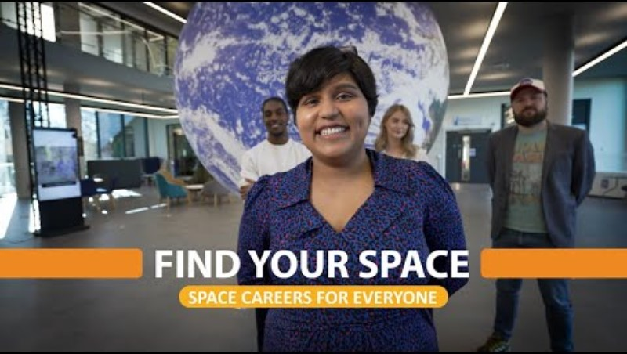
Rochelle – Aerospace Medicine
Researcher
You can get into this job through:
A university course or working towards this role.
University
You'll need a good honours degree in a medical or life science subject to become a medical researcher. Relevant subjects include:
biochemistry
biomedical sciences
genetics
immunology
medical microbiology
molecular biology
pharmacology
physiology.
Entry requirements
You'll usually need:
2 to 3 A levels, or equivalent, for a degree
Link to video - https://youtu.be/d7n4bIIxQB4
R
The average salary for a Scientific researcher in the UK is £33,000.
https://nationalcareers.service.gov.uk/job-profiles/research-scientist
https://www.prospects.ac.uk/job-profiles/research-scientist-medical
https://www.payscale.com/research/UK/Job=Researcher%2C_Scientific/Salary

Slide 25
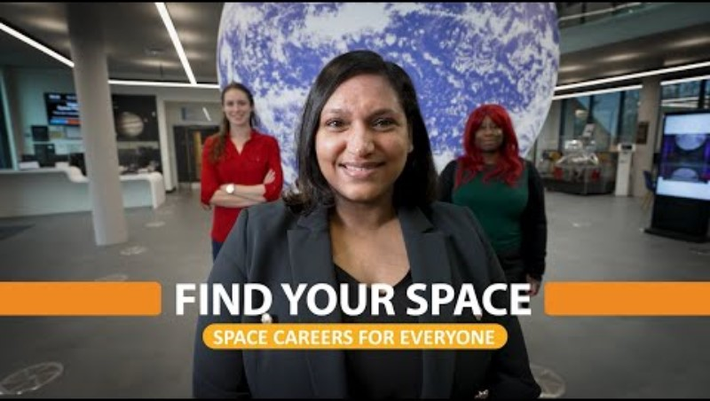
Asha – Human Resourcing Advisor
You can get into this job through:
A university course, a college course, an apprenticeship or specialist courses run by professional bodies
University
You could do a foundation degree, higher national diploma or degree in any subject. You could then apply for a graduate HR training scheme.
You may have an advantage if you study an HR related subject like:
human resources management
business management and human resources
psychology
economics
Entry requirements
You'll usually need:
1 or 2 A levels, or equivalent, for a foundation degree or higher national diploma
2 to 3 A levels, or equivalent, for a degree
a degree in any subject for a postgraduate course
Link to video - https://youtu.be/s3a89gEPgUo
H
The average salary for a Human resources manager in the UK is £38,000.
https://nationalcareers.service.gov.uk/job-profiles/human-resources-officer
https://www.prospects.ac.uk/job-profiles/human-resources-officer
https://www.payscale.com/research/UK/Job=Human_Resources_(HR)_Manager/Salary

Slide 26
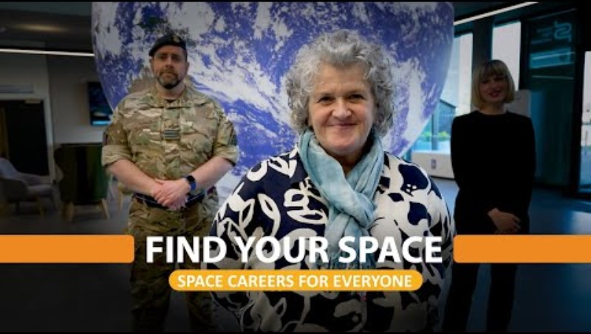
Angela – Manufacturing Process
Manager
You can get into this job through:
a university course
an apprenticeship
working towards this role
applying directly
University
You could do a foundation degree, higher national diploma or degree in manufacturing. Some employers may look for a degree of relevance to their particular industry, for example:
automotive or aerospace engineering
food production
pharmaceuticals
chemical engineering
materials engineering
Entry requirements
You'll usually need:
1 or 2 A levels, or equivalent, for a foundation degree or higher national diploma
2 to 3 A levels, or equivalent, for a degree
Link to video - https://youtu.be/JQeYjBrQPVg
M
The average salary for a Manufacturing manager in the UK is £46,000.
https://www.prospects.ac.uk/job-profiles/production-manager
https://www.payscale.com/research/UK/Job=Manufacturing_Manager/Salary
https://nationalcareers.service.gov.uk/job-profiles/production-manager-manufacturing-

Slide 27
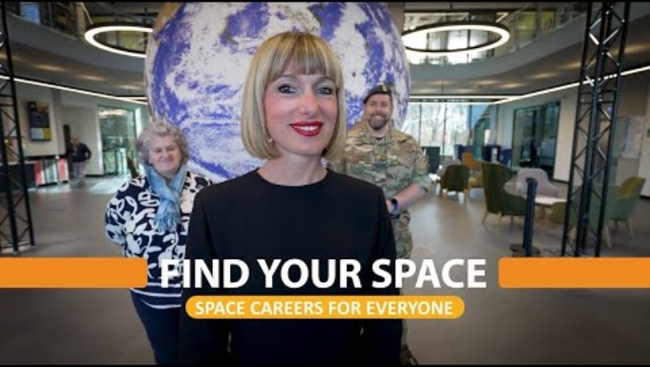
Elisa – Professor of Neuroscience
You can get into this job through:
a university course
an apprenticeship
University
You'll usually need a first class or upper second class degree, relevant to the subject you want to teach.
You'll also need to have completed a postgraduate master's or PhD qualification, or be working towards one. It's common to have had academic work published.
You'll be expected to do a teaching qualification soon after you start. This is normally offered by your university and is done while working.
Entry requirements
You'll usually need:
2 to 3 A levels, or equivalent, for a degree
a degree in a relevant subject for postgraduate study
Link to video - https://youtu.be/8fEsE83wFis
F
The average salary for a Professor in the United Kingdom is £74,000.
https://nationalcareers.service.gov.uk/job-profiles/higher-education-lecturer
https://www.prospects.ac.uk/job-profiles/higher-education-lecturer
https://www.payscale.com/research/UK/Job=Professor%2C_Postsecondary_%2F_Higher_Education/Salary

Slide 28
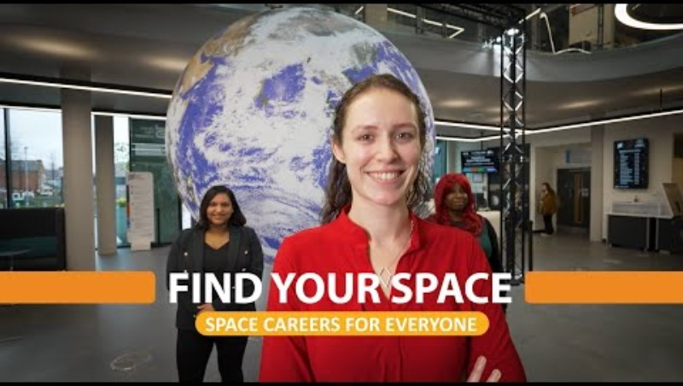
Hannah – Planetary Scientist
You can get into this job through:
a university course
an apprenticeship
working towards this role
University
You usually need a first or 2:1 (upper second class) degree in a science subject to become a research scientist. Most research scientists continue to study for a postgraduate qualification like a PhD.
You could study on an integrated postgraduate master's course. These courses include independent research and are designed to lead directly on to a PhD.
Entry requirements
You'll usually need:
2 or 3 A levels, or equivalent, including a science, for a degree
a degree in a relevant subject for postgraduate study
Link to video - https://youtu.be/CjzaYI-rbxU
R
The average salary for a Planetary scientist in the UK is £35,000.
https://nationalcareers.service.gov.uk/job-profiles/research-scientist
https://www.glassdoor.co.uk/Salaries/planetary-science-salary-SRCH_KO0,17.htm

Slide 29
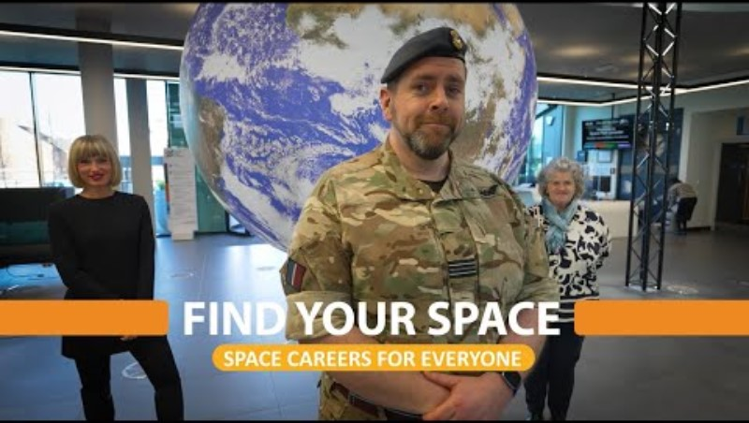
Flt Lt Greenwood – RAF
Lieutenant & Space Command Liaison
You can apply directly for roles as an RAF officer. You'll need a minimum of:
5 GCSEs at grades 9 to 4 (A* to C), including English and maths, and a science for some roles
2 A levels or equivalent qualifications
If you're successful, you'll be invited to attend the Officers and Aircrew Selection Centre at RAF College, Cranwell in Lincolnshire. You'll take part in a one-day selection process which includes tests for aptitude, initiative and fitness. You'll then have an interview and a medical examination.
Air Cadets
If you're between 13 and 17 years old, you can join the Air Cadets.
The skills you learn and experiences you gain will benefit you whatever career path you choose. Cadets have many opportunities, including UK and overseas camps, leadership courses and air experience flights.
Link to video - https://youtu.be/qZVjYvhcORM
P
The average salary for a RAF officer in the United Kingdom is £39,000.
https://nationalcareers.service.gov.uk/job-profiles/raf-officer
https://www.prospects.ac.uk/job-profiles/armed-forces-operational-officer

Slide 30
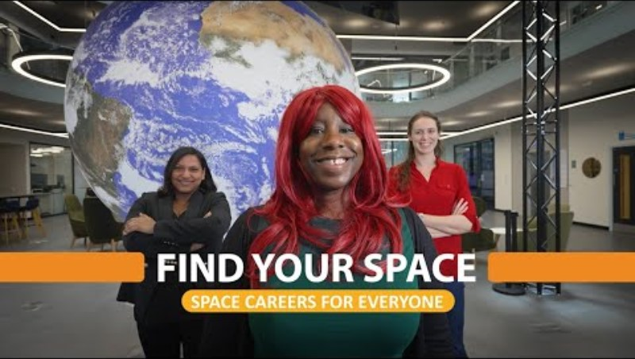
Melissa – Space Journalist
You can get into this job through:
A university course, a college course, an apprenticeship, working towards this role
or specialist courses run by professional bodies
University
You can take a degree course as a first step towards this career. Relevant subjects include:
English
journalism
media and communications
Some courses are accredited by the National Council for the Training of Journalists.
Graduates of other subjects can do a postgraduate course in journalism, lasting 1 to 2 years.
Entry requirements
You'll usually need:
2 to 3 A levels, or equivalent, for a degree
a degree in any subject for a postgraduate course
Link to video - https://youtu.be/tDMyvHEQyAs
C
The average salary for a Journalist in the United Kingdom is £26,000.
https://www.payscale.com/research/UK/Job=Journalist/Salary
https://www.prospects.ac.uk/job-profiles/science-writer
https://nationalcareers.service.gov.uk/job-profiles/newspaper-journalist

Slide 31
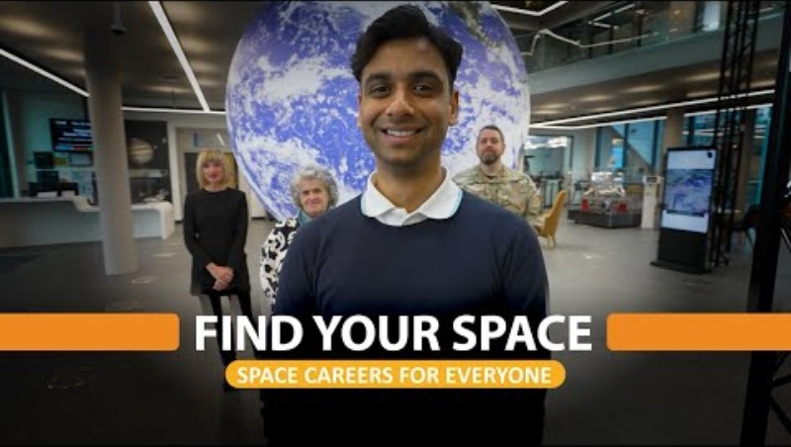
Parthil – Mechanical Engineer
You can get into this job through:
A university course, a college course, an apprenticeship or working towards this role
University
You could do a higher national diploma or degree in:
mechanical engineering
electromechanical engineering
mechatronics
engineering manufacturing
The Engineering Council has information on accredited courses.
Entry requirements
You'll usually need:
2 or 3 A levels, or equivalent, including maths and physics
Link to video - https://youtu.be/CaO-R3Om9zc
E
The average salary for a Mechanical Engineer in the UK is £34,000.
https://nationalcareers.service.gov.uk/job-profiles/mechanical-engineer
https://www.payscale.com/research/UK/Job=Mechanical_Engineer/Salary
https://www.prospects.ac.uk/job-profiles/mechanical-engineer

Slide 32
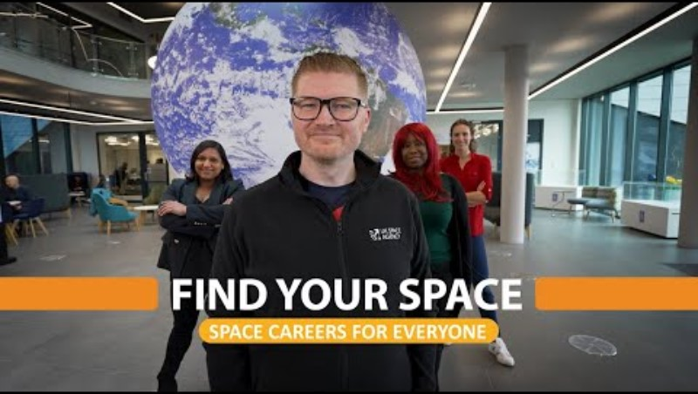
Craig – Director of Investment
You can get into this job through:
A university course, an apprenticeship or combining work with studying a professional qualification
University
You could do a degree in any subject then apply for a place on a graduate training scheme to work towards a professional accountancy qualification.
If you want to take a more focused route onto a graduate scheme, you could study for an accountancy related degree, like:
accountancy
accounting and finance
business and management
maths
Entry requirements
You'll usually need:
2 to 3 A levels, or equivalent, for a degree
4 or 5 GCSEs at grades 9 to 4 (A* to C), or equivalent, including English and maths
Link to video - https://youtu.be/8lu9lP2da5E
B
The average salary for an Investment manager in the UK is £59,000
https://www.payscale.com/research/UK/Skill=Investment_Management/Salary
https://nationalcareers.service.gov.uk/job-profiles/management-accountant

Slide 33
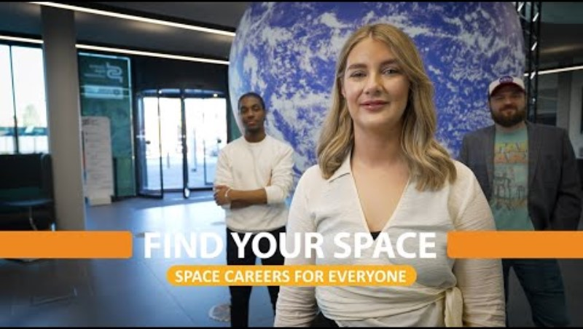
Faye – Equipment Engineering
Manager
You can get into this job through:
A university course, a college course, an apprenticeship or working towards this role
University
You could do a degree in aerospace engineering, avionics, or a subject like:
electrical or electronic engineering
mechanical engineering
manufacturing or product engineering
physics or applied physics
software engineering or mathematics
Postgraduate study
You may be able to do a master's degree in aeronautical or aerospace engineering if you've studied for a degree in a related subject, such as engineering.
Entry requirements
You'll usually need:
2 or 3 A levels, or equivalent, including maths and physics
a degree in a relevant subject for postgraduate study
Link to video - https://youtu.be/rO4sc5fS_FQ
E
The average salary for an Engineering manager in the UK is £50,000.
https://www.payscale.com/research/UK/Job=Engineering_Manager/Salary
https://nationalcareers.service.gov.uk/job-profiles/purchasing-manager

Slide 34
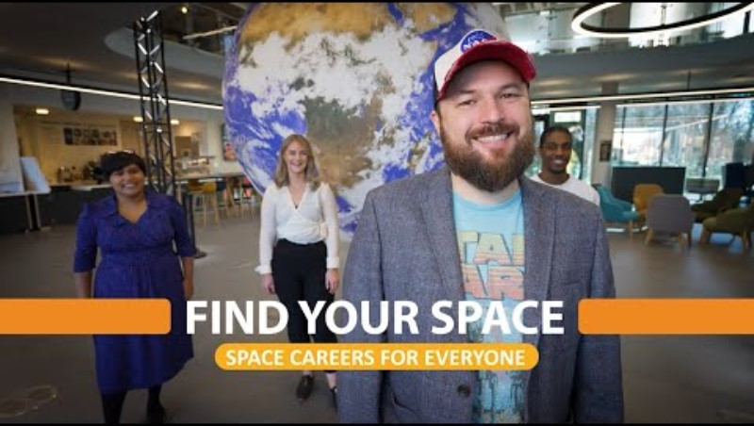
Paul – Director of NSC Creative
You can get into this job through:
A university course or working towards this role.
University
Getting a degree in any subject can help you get into this type of job, although a course relevant to the subject you want to be an expert in may give you an advantage.
You can take postgraduate qualifications in the subject to increase your understanding, though they are not essential for getting into the role.
Entry requirements
You'll usually need:
2 to 3 A levels, or equivalent, for a degree
Link to video - https://youtu.be/CmEaE5p-pjk
A
The average salary for a Creative director in the UK is £51,000.
https://www.payscale.com/research/UK/Job=Creative_Director/Salary
https://www.prospects.ac.uk/job-profiles/creative-director

Slide 35
Further Find Your Space resources
Our quickfire videos feature Find Your Space interviewees answering short, snappy questions off the cuff!
Use these videos to inspire further discussion about the careers and lives of our interviewees.
Follow the link below for the Quickfire Playlist:
https://www.youtube.com/playlist?list=PLrrRtiBgUv4nCvjAgpNF8OGwgnaL8Nrod

Slide 36



Would you like more information?
https://spacecareers.uk/home
https://www.ukspace.org/careers/
https://www.gov.uk/government/publications/space-related-educational-resources/uksa-careers-leaflet

Slide 37
Frequently asked questions
Why should I work in the space sector?
The space sector is growing very quickly, there's a massive shortage of people studying these technical subjects, there's a lot of jobs out there and the jobs are well paid. I think it's a fun job, it's always different you know, no two days are the same. Ben
What sort of impact can I make with a job in the space sector?
Space is an entire field of endeavour. If you want a career that also will make a difference to Humanity's future in terms of the environment, in terms of connectivity, in terms of lifting people out of poverty, space will unlock a lot of answers to our problems. and you will be doing good things and you will be paid well and there will always be a job for you. David
Is being female a barrier to working in the space sector?
When I got to college and I decided to study Physics, I was one of three girls in our class and I noticed that there was an imbalance, but actually, I wasn't limited for many of the opportunities at that point…
As a female I would say that I definitely feel like as we're progressing into the future, actually it's an advantage to have or to be different. What we're looking for now is a more diverse range of people with a diverse range of skills and perhaps you, as someone who doesn't make up the majority of the group, can bring something that other people might not be able to. Dhara
Quick fire questions - https://www.youtube.com/playlist?list=PLrrRtiBgUv4nCvjAgpNF8OGwgnaL8Nrod

Slide 38
Frequently asked questions
Do I have to decide what I want to do now to succeed?
It is a fantastic industry to be involved in. But where you end up might not be where you thought you were going to end up, so be open to the other opportunities, be open to everything that is out there and find something that that really excites you because when you do it becomes that much easier. Colin
Do I have to take triple science to get a space related job?
I went to a comprehensive school, we did dual award science because that was what the school did, I didn't do further maths because it wasn't offered and they were not barriers, they might have made things easier, but the fact that I didn't do them wasn't a problem, the fact that I didn't go to a selective School wasn't a problem…. it helped that the university recruits from a wide base of students. Sarah
What advice would I give to your 16 year old self?
Listen to your intuition and don't be scared to follow the path that you want to go on. Just because it might not be what everyone else is doing doesn't mean it's wrong, just go for it, don't second guess yourself.
Sometimes even at school in your best subjects or your worst subjects you might be doing bad in the grades, but it doesn't mean that you should give up on them if you're interested in the subject, it's just you haven't found your way of learning it yet. Loz
Quick fire questions - https://www.youtube.com/playlist?list=PLrrRtiBgUv4nCvjAgpNF8OGwgnaL8Nrod

Slide 39
The eight Gatsby benchmarks of Good Career Guidance are:
1. A stable careers programme - Permanent fixture of developing resources on the site.
2. Learning from career and labour market information – Labour market info. The number of people employed in the relevant industry in the UK / Europe. Industry growth. Future study options. https://www.lmiforall.org.uk/
3. Addressing the needs of each pupil – Should be clear what age it is aimed at and relevant to them. Should embed equality and diversity throughout. Give examples of jobs at all levels of education. Show people of different backgrounds.
4. Linking curriculum learning to careers - What subjects does it relate to at school, A-levels / Degree required.
5. Encounters with employers and employees - Every pupil should have opportunities to learn from employers about work, employment and the skills that are valued in the workplace.
6. Experiences of workplaces
7. Encounters with further and higher education - All pupils should understand the full range of learning opportunities that are available to them. This includes both academic and vocational.
8. Personal guidance – Required from qualified practitioners.

